Slide 1
Optical Character Recognition and Correction for Images of Digital Displays Brian Cornet
May 3rd, 2021
DSC 498 – Dr. Donghui Yan
DSC 499 – Dr. Scott Field

Slide 2
Part 1:
What’s the deal?

Slide 3
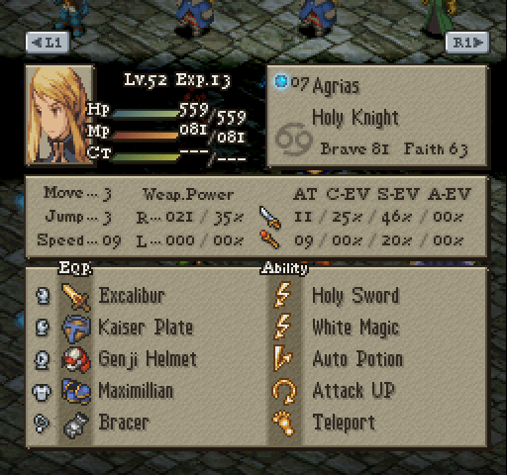
Purpose
A platform for collecting data from images
Data is not private, but collection by hand is tedious and prone to error
This took me 3 minutes to type!
I need to do it 20 more times…
Surely there’s a better way?
Final Fantasy Tactics (Sony PlayStation)

Slide 4
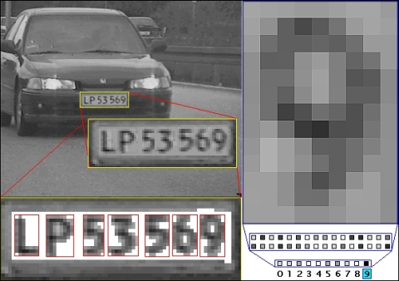
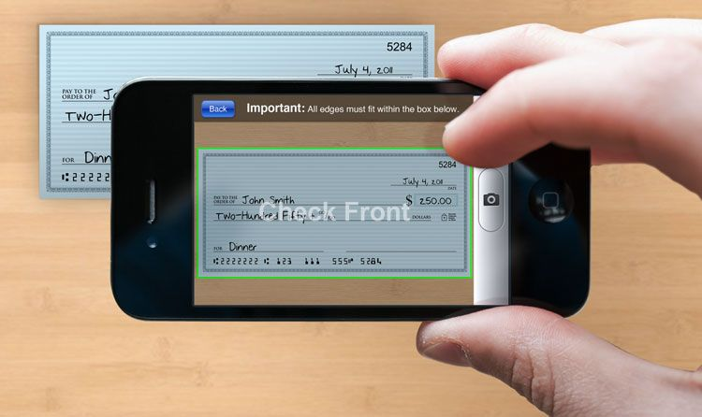
Optical Character Recognition (OCR)
Converts images of text into digital text
Commonly used for scanning documents and in AI services (self-driving cars, etc.)
Typically relies on pattern recognition

Slide 5
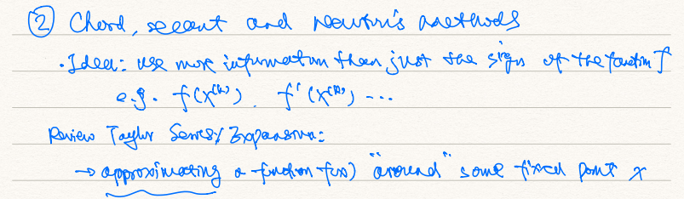
Optical Character Recognition (OCR)
Relies on predictive modeling from machine learning
If a human can’t read it, chances are a machine can’t either!
← (Thanks Yanlai!)
OCR Interpretation (74.28% Mean Accuracy) | Actual Text
Chord secant and Navon's adeterods Idea usemoreinformationthan just the sign ofthefaaetimf ego fexch f exam ReviewTaylor Serves Expansive approximating afractionfun around some fixed point x | ② Chord, Secant, and Newton’s methods • Idea: use more information than just the sign of the function f e.g. f(x^{(k)}), f’(x^{(k)}) … Review Taylor Series Expansion: → approximating a function f(x) “around” some fixed point x
Line acc:
73.23%
85.00%
40.00%
86.67%
86.49%

Slide 6
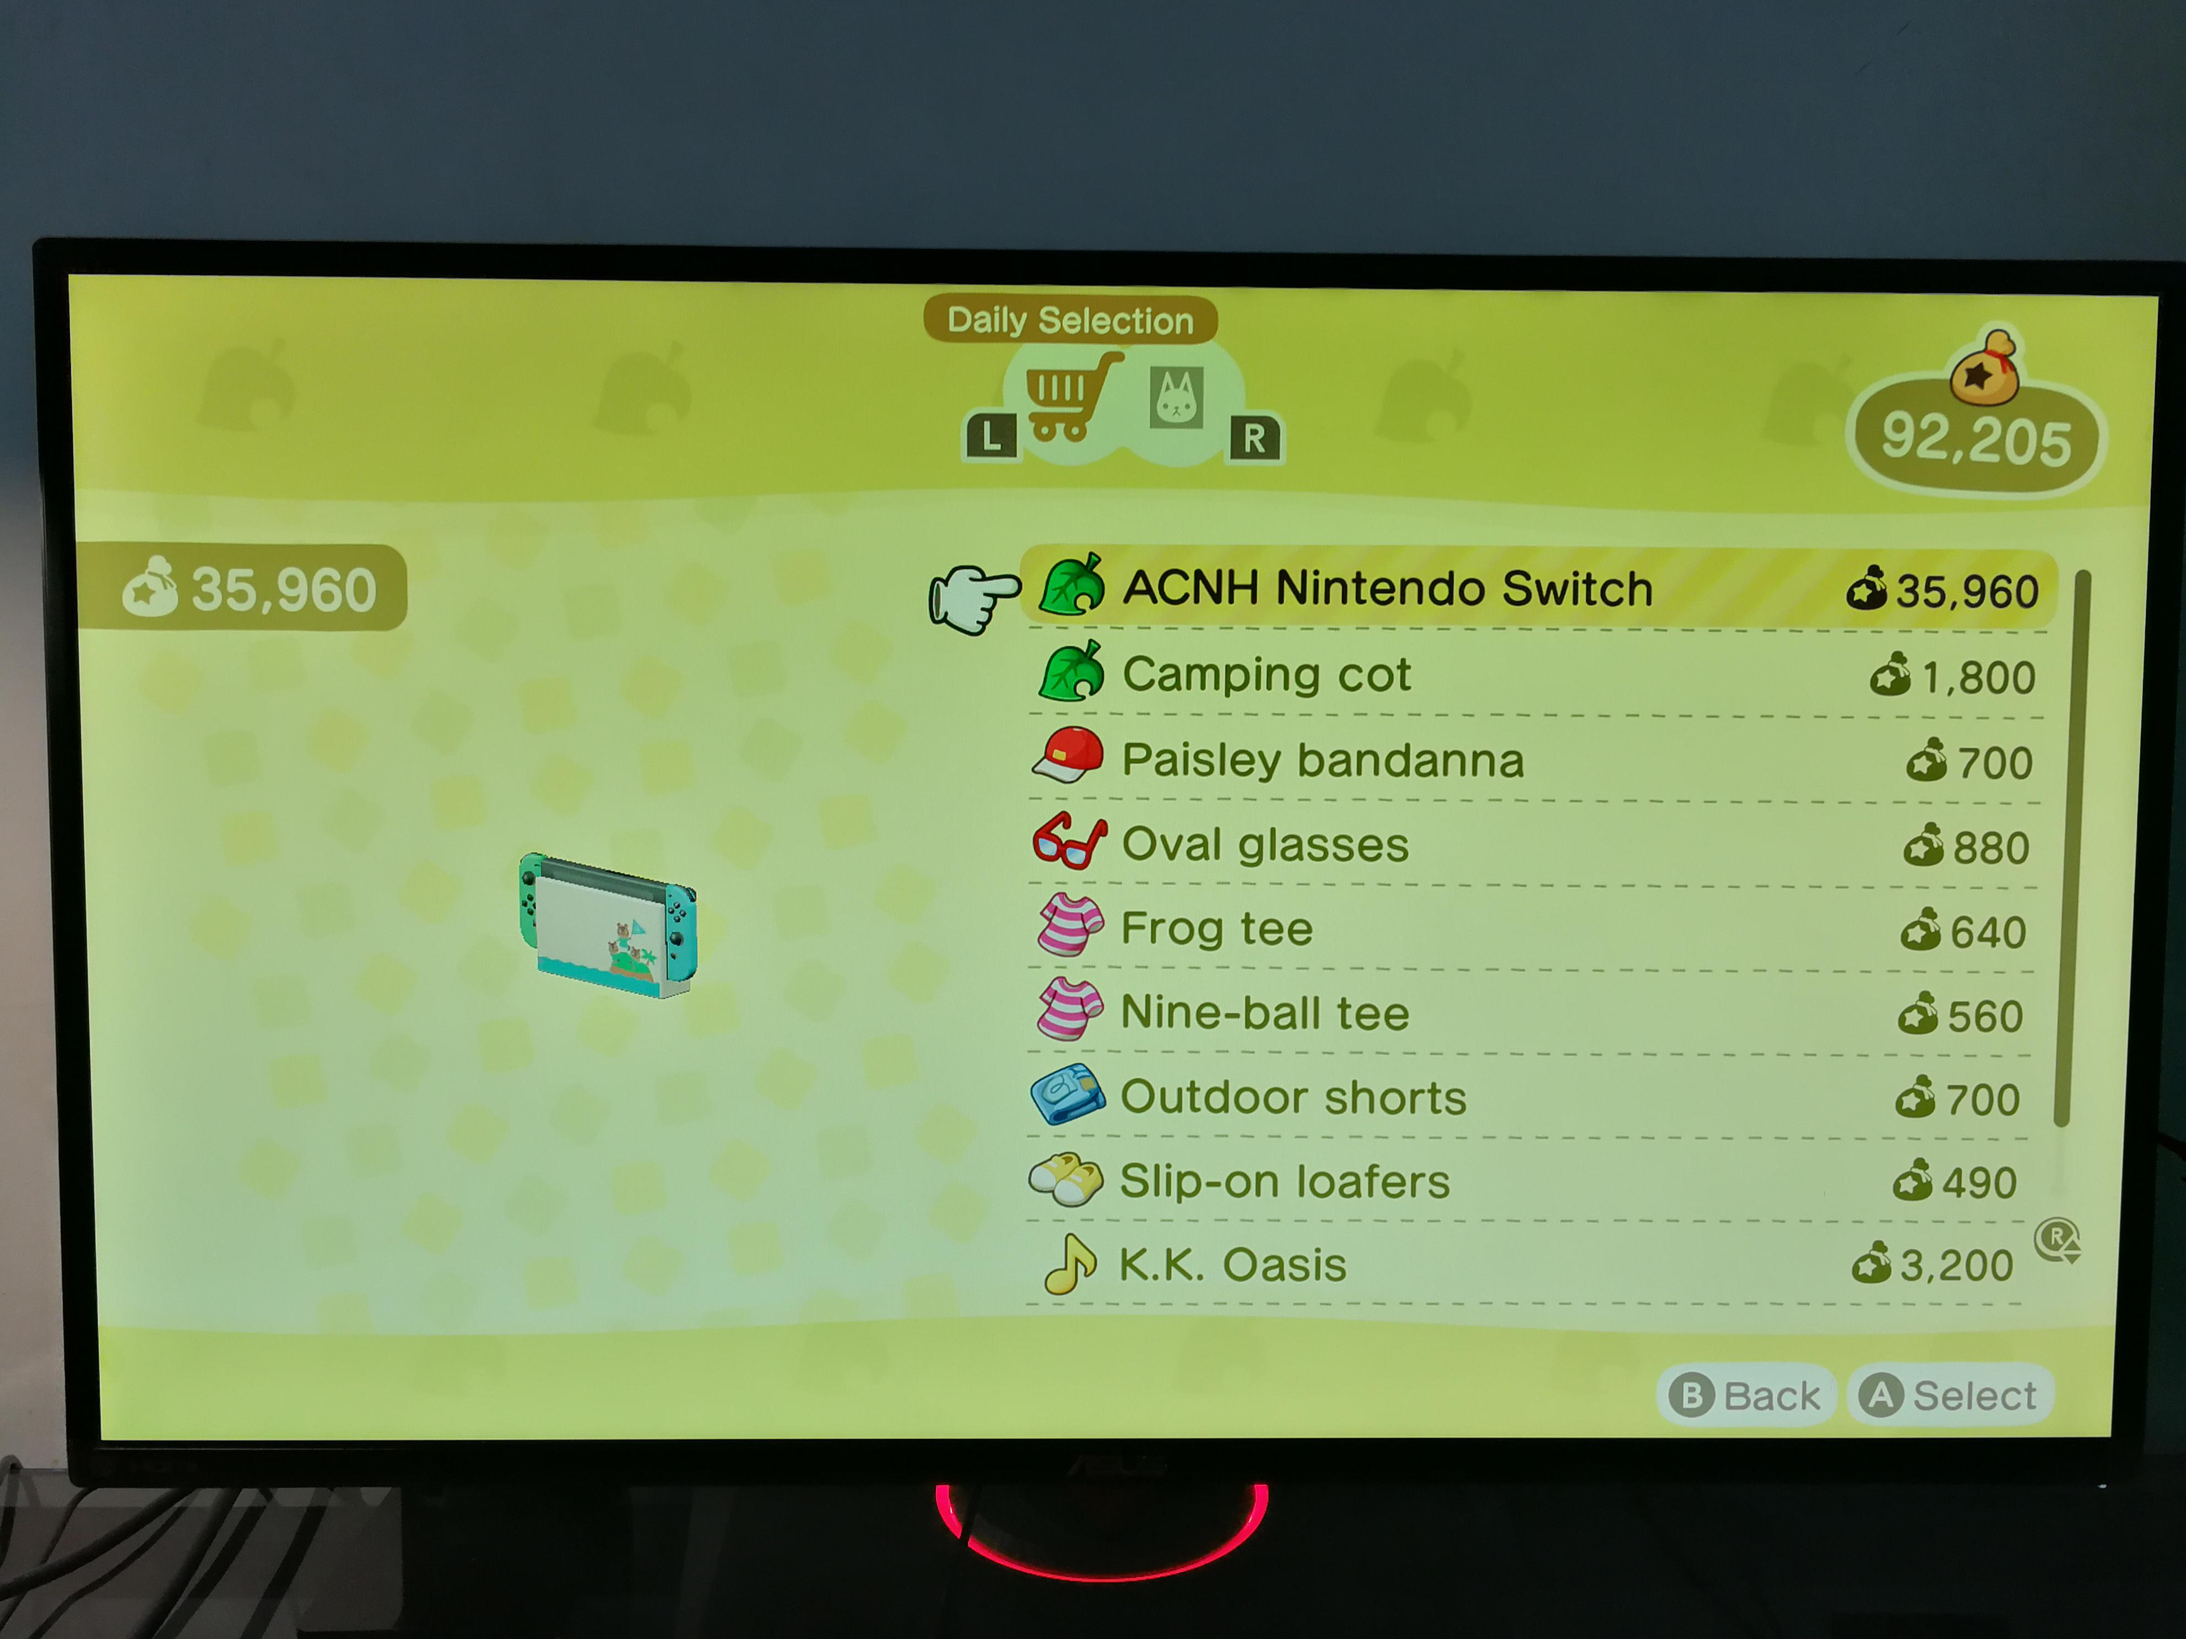
Objectives
Create platform for data collection from images (including images of images!)
ACNH Nintendo Switch
Camping cot
Paisley bandanna
Oval glasses
Frog tee
Nine-ball tee
Outdoor shorts
Slip-on loafers
K.K. Oasis
Animal Crossing: New Horizons (Nintendo Switch)
Lists!

Slide 7
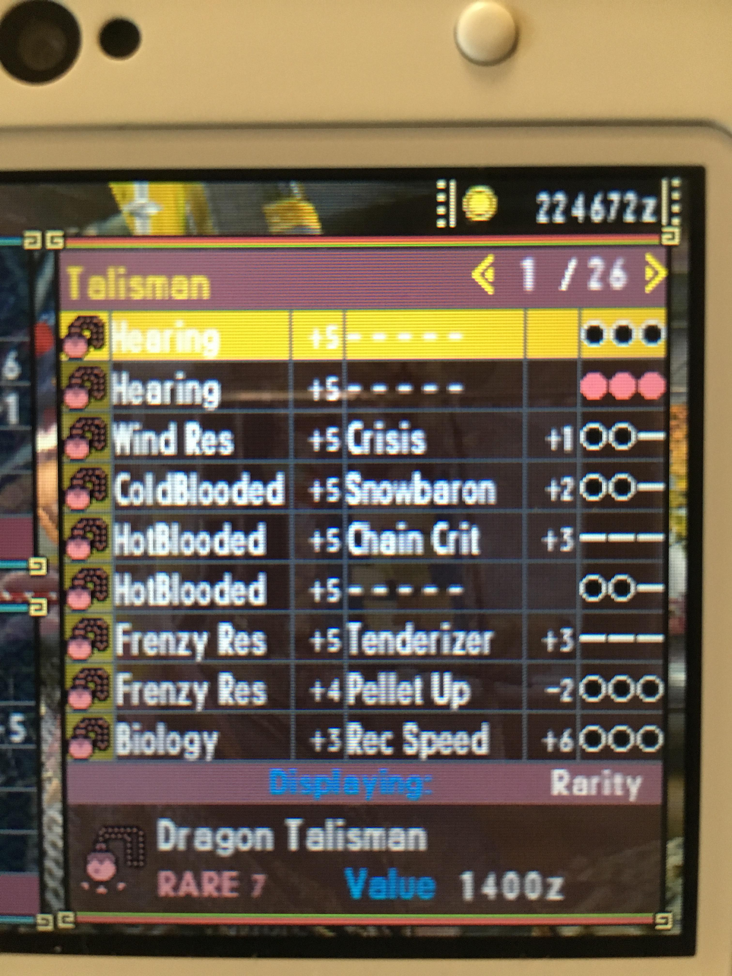
Objectives
Create platform for data collection from images (including images of images!)
Hearing | +5 | – – – – – |  | OOO
Hearing | +5 | – – – – – |  | OOO
Wind Res | +5 | Crisis | +1 | OO–
ColdBlooded | +5 | Snowbaron | +2 | OO–
HotBlooded | +5 | Chain Crit | +3 | –––
HotBlooded | +5 | – – – – – |  | OO–
Frenzy Res | +5 | Tenderizer | +3 | –––
Frenzy Res | +4 | Pellet Up | –2 | OOO
Biology | +3 | Rec Speed | +6 | OOO
Tables!
Monster Hunter Generations (Nintendo 3DS)

Slide 8
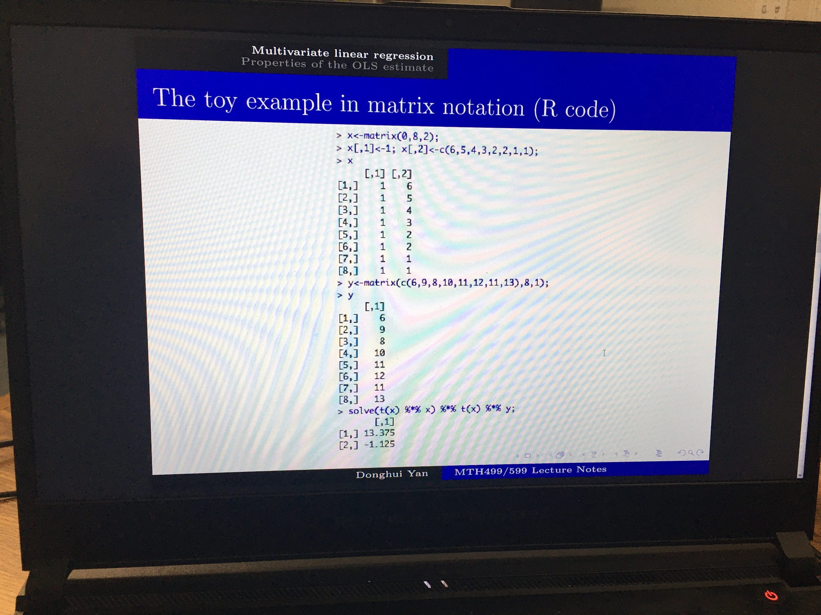
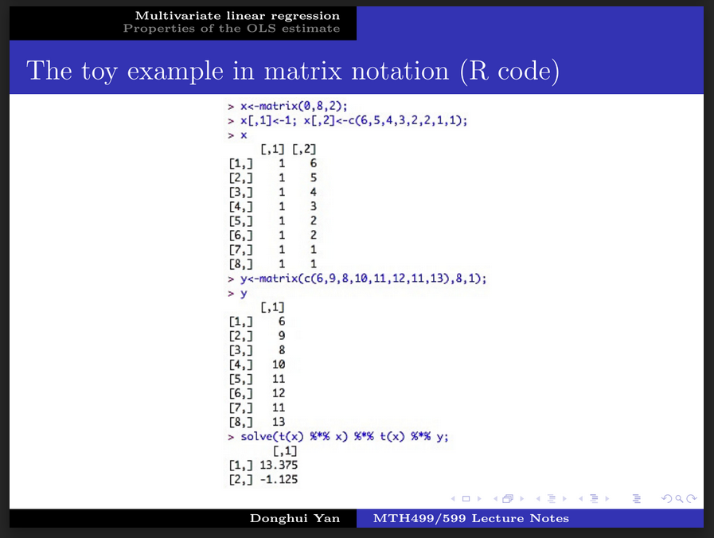
Objectives
Include predictive image correction for camera images and elaborate designs
Clean!

Slide 9
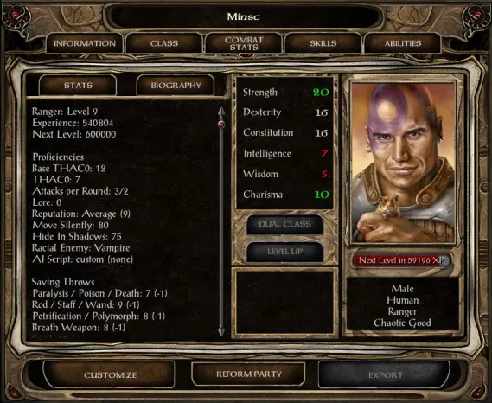

Objectives
Include predictive image correction for camera images and elaborate designs
Baldur’s Gate II: Shadows of Amn (PC)
Pokémon: Let's Go, Pikachu! and Let's Go, Eevee! (Nintendo Switch)

Slide 10

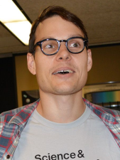



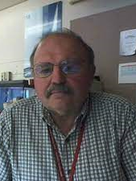
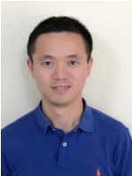
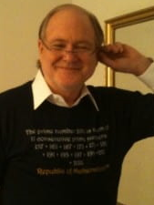
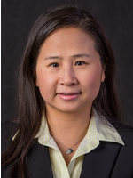

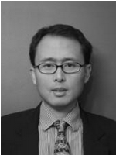
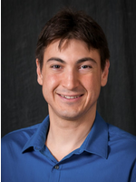
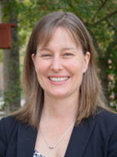


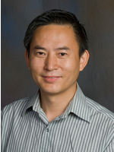

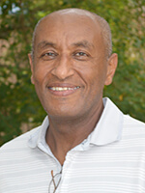
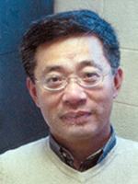

Platforms and Awesome People

Slide 11
Part 2:
Understanding Tesseract OCR

Slide 12
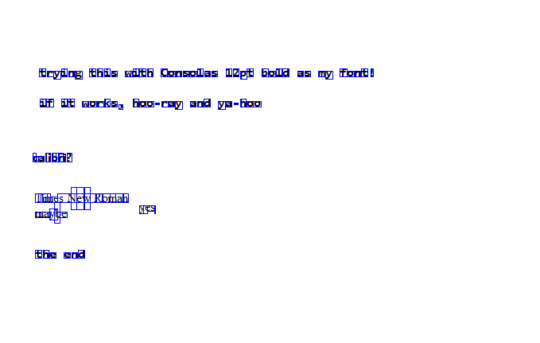
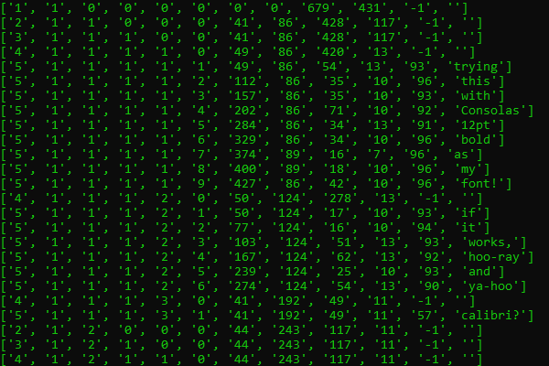
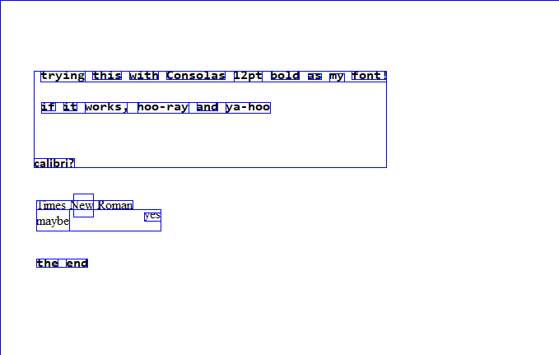
Simple Word Scan
Representation of Word Locations
Data from pytesseract.image_to_data()

Slide 13
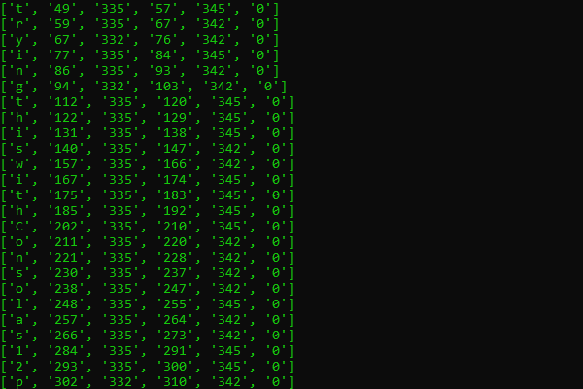
Simple Character Scan
Representation of Character Locations
Data from pytesseract.image_to_boxes()

Slide 14
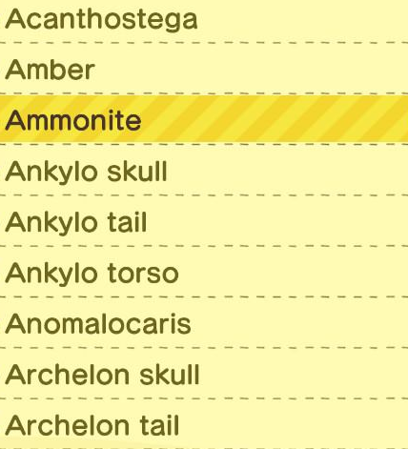

Block Test 1 – Animal Crossing
Acanthostega
Archelon tail
♀
Anomalocaris
♀
Output improves when parsing piece by piece…

Slide 15
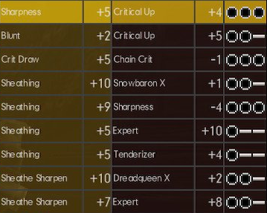

Block Test 2 – Monster Hunter
Tg
ert
Sheathing
SE)
Sheathing
Sheathing
Sheathe Sharpen
Sheathe Sharpen
+2 Critical Up
+5 Chain Crit
Baio cig
SSL tak
Sen
Secrets
BUCS
Baie os
be)
a a
Saal
a
al
Br Ot
cele
Ss) ad
♀
Sheathing +10 Srowboron X Saad
♀
…But sometimes that’s still not enough!

Slide 16
Part 3:
Image Transformations
(the ones that worked, anyway)

Slide 17
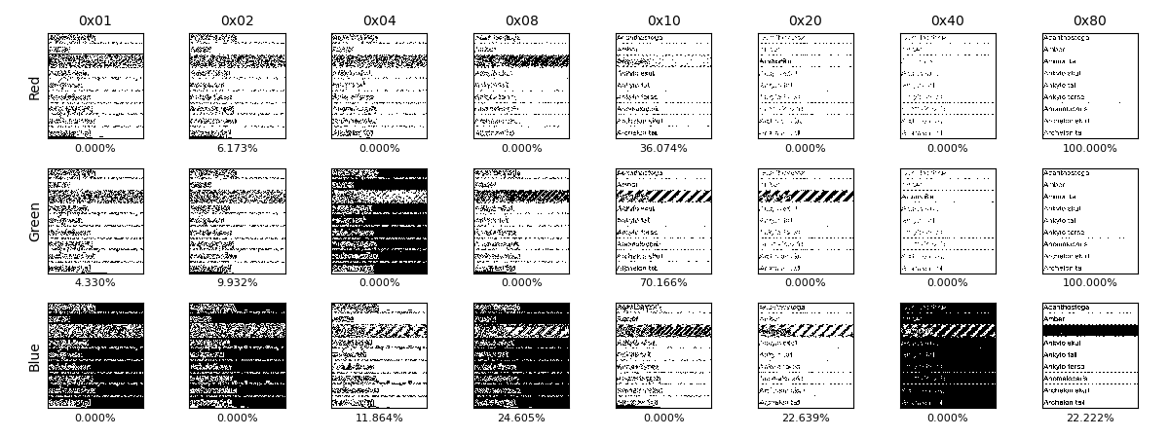

Binarization and Thresholding
Binarization: set pixels to black or white based on brightness (black text on white is best)
Thresholding: assign different brightness cutoffs for binarization

Slide 18
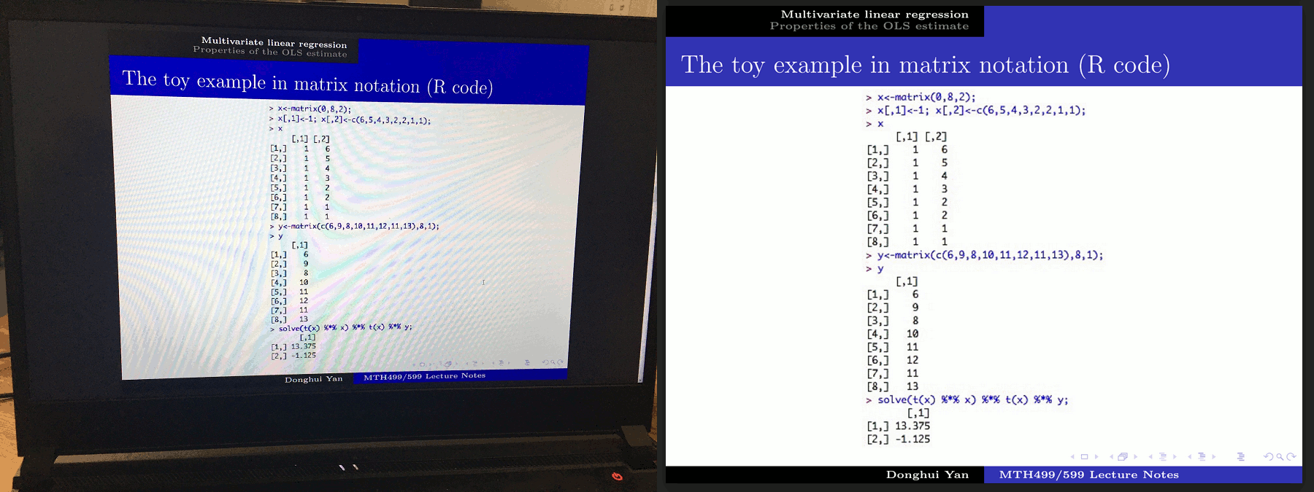
Rotation and Skewing – Matching
Detect and compare similar feature positions; requires similar details in both images

Slide 19
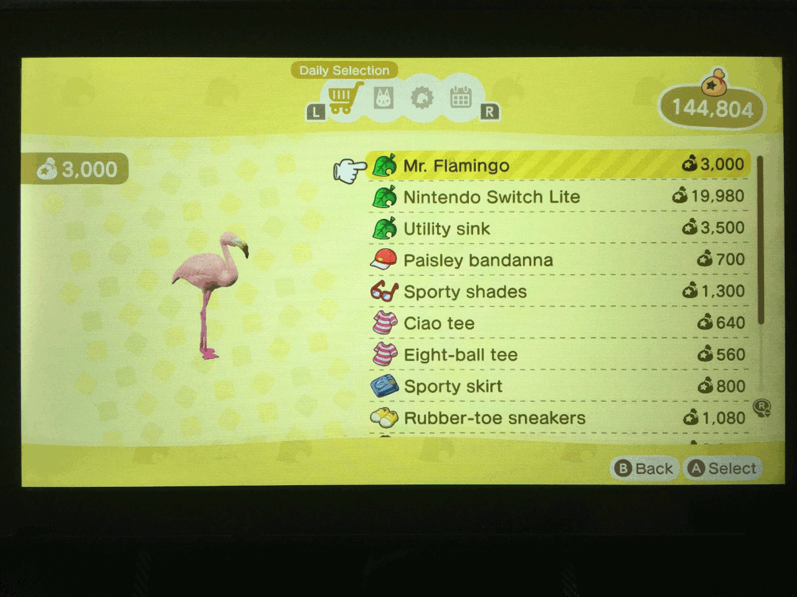
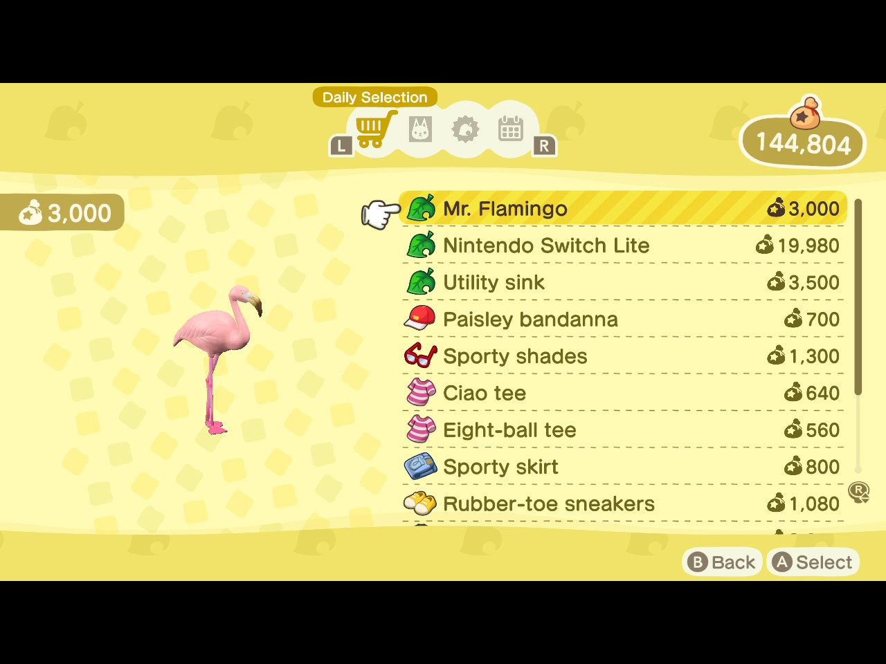
Rotation and Skewing – Edges
Uses Canny edge detection, Hough lines, then transform (requires clear edges)

Slide 20
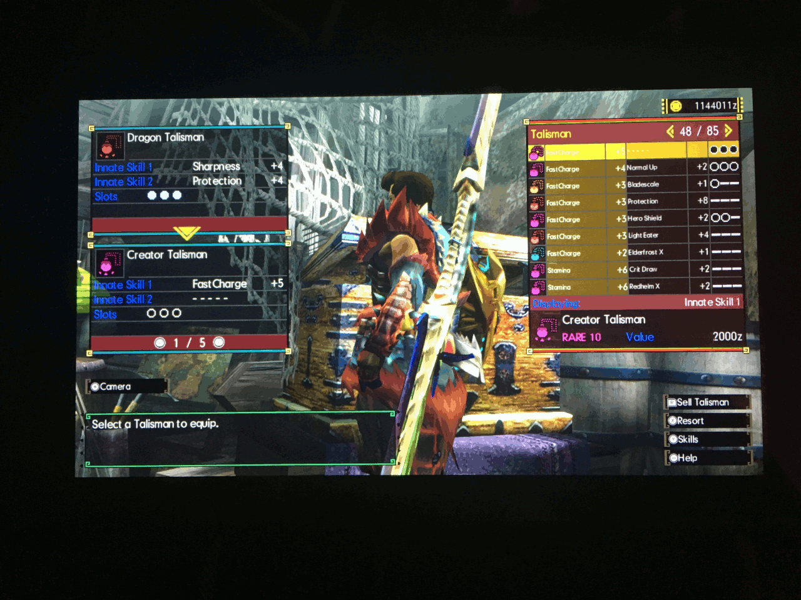
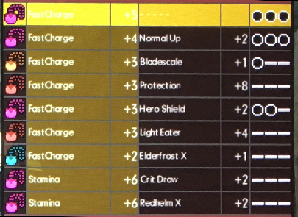
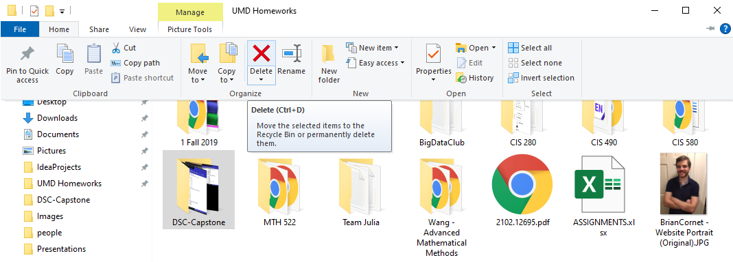
Rotation and Skewing – Hand-holding
If all else fails, require user input to crop or predetermine row/column spaces

Slide 21
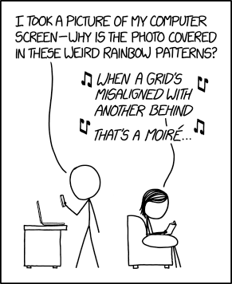
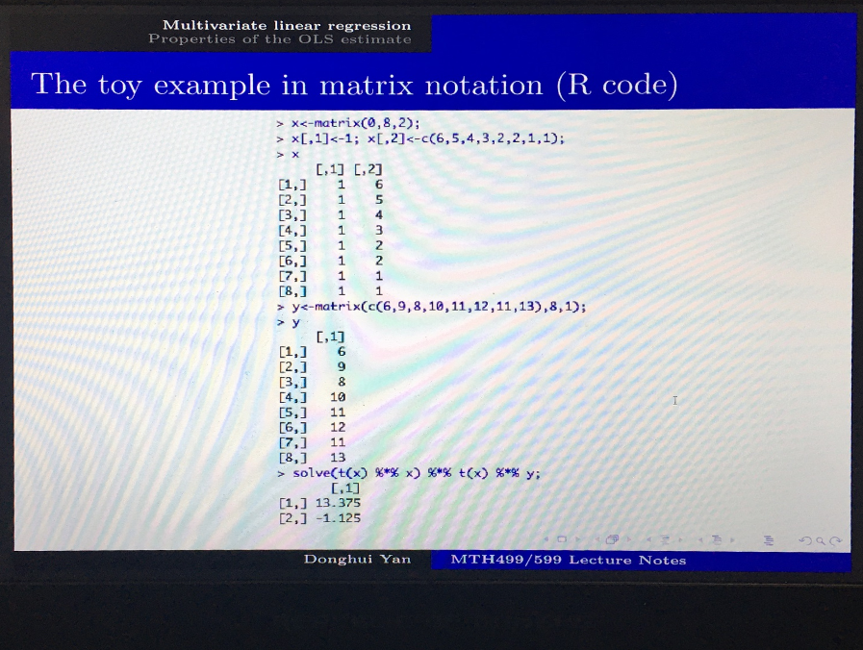
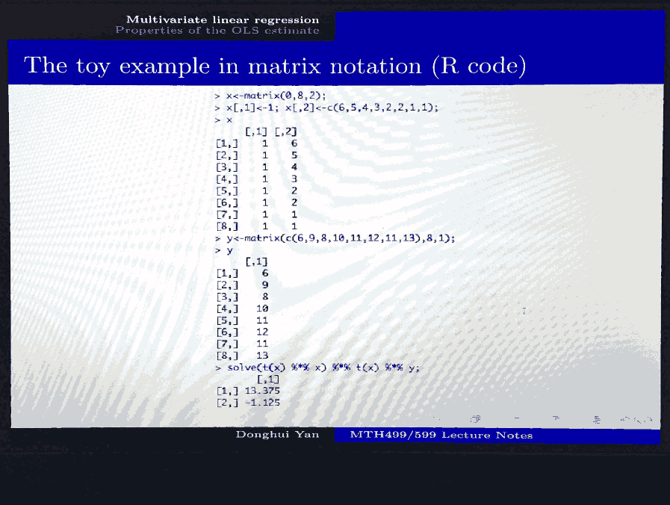
Noise Removal
Eliminate camera noise or background textures – can optionally apply to “empty” cells
Moiré patterns may be introduced from rotation methods

Slide 22
Part 4:
Dictionary-based Text Correction

Slide 23
Dictionary Implementation
Use pre-defined dictionary for given location, then use Levenshtein distance to match
Extremely effective but requires additional user input
Sharpness 45 Ceticol Up +4 oo
Blunt +2 Crticol Up +5 oo
Crk Drow 45 Choin Grit 1 oo
Sheathing +10 Snowbaron X +1 oo
Steathing 9 Shoreness -4 oo
Steathing +5 Expert +10 oo
Steahing +5 Tenderizer +4 oo
Sheathe Sherpen +10 Drecsueen X +2 oo
Sheathe Shorpen +7 Expert +8 oo
No dictionary:
86.41% accuracy
89.74% accuracy for word columns
Sharpness -5 Critical Up +4 oo-
Blunt +2 Critical Up +5 oo-
Crit Draw -5 Chain Crit -1 oo-
Sheathing +10 Snowbaron X +1 oo-
Sheathing -9 Sharpness -4 oo-
Sheathing +5 Expert +10 oo-
Sheathing +5 Tenderizer +4 oo-
Sheathe Sharpen +10 Dreadqueen X +2 oo-
Sheathe Sharpen +7 Expert +8 oo-
With dictionary:
92.96% accuracy
100.00% accuracy for word columns

Slide 24
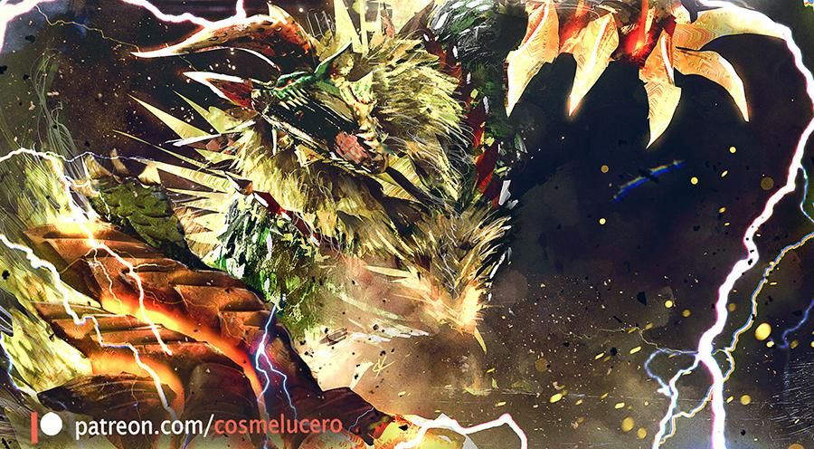
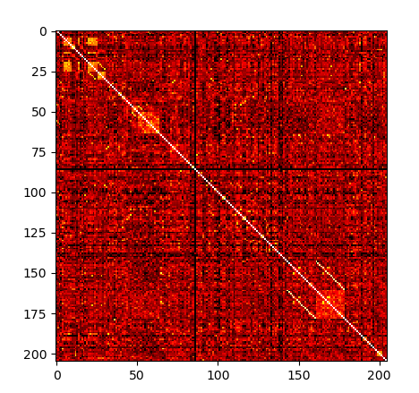
Dictionary Limits
Similar words may be misinterpreted (“couch” vs. “conch”)
Levenshtein matrix estimates error likelihood
MHGU Skill Names:
205 unique items
11.10% mean distance
Thunderlord Thunderlord X 0.916667
Wind Res Bind Res 0.875000
Fencing D. Fencing 0.823529
Poison Poison C+ 0.800000
Hearing Hoarding 0.800000
Dead Eye Deadeye 0.800000
Loading Hoarding 0.800000
Pierce Up Pierce S+ 0.777778
Frenzy Res Fire Res 0.777778
Sharpener Sharpness 0.777778
Very common for one term to extend another!

Slide 25
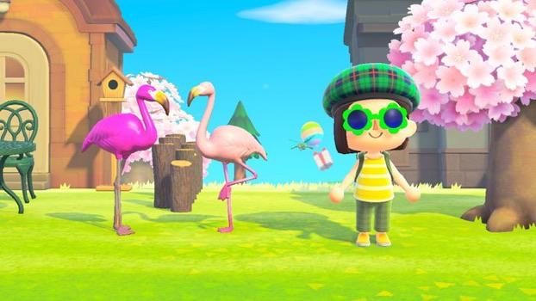
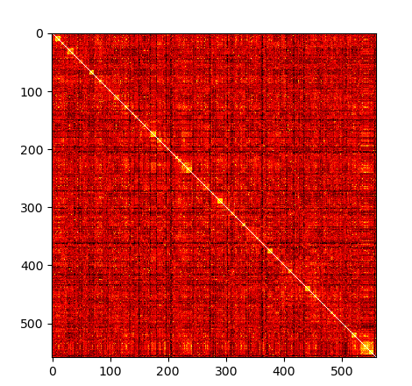
Dictionary Limits
ACNH Houseware Names:
559 unique items
29.09% mean distance
More items to compare means greater error risk!
Mr. Flamingo Mrs. Flamingo 0.960000
stone tablet stone table 0.956522
peach chair beach chair 0.909091
music stand mic stand 0.900000
ironwood chair ironwood cart 0.888889
diner mini table diner dining table 0.882353
wooden-block bed wooden-block table 0.882353
wooden-block bed wooden-block bench 0.882353
ironwood low table ironwood table 0.875000
wooden-block stool wooden-block stereo 0.864865
Could be a problem!

Slide 26
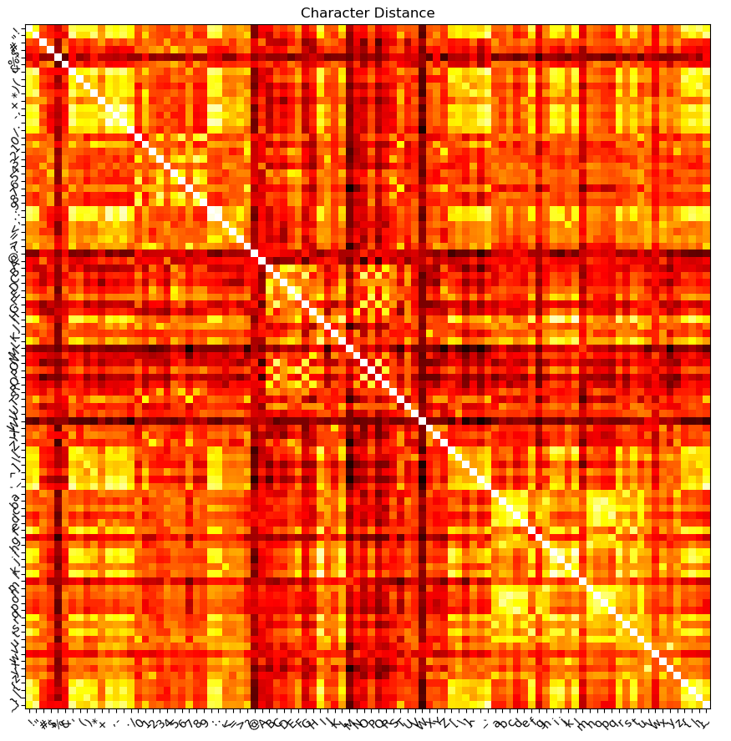
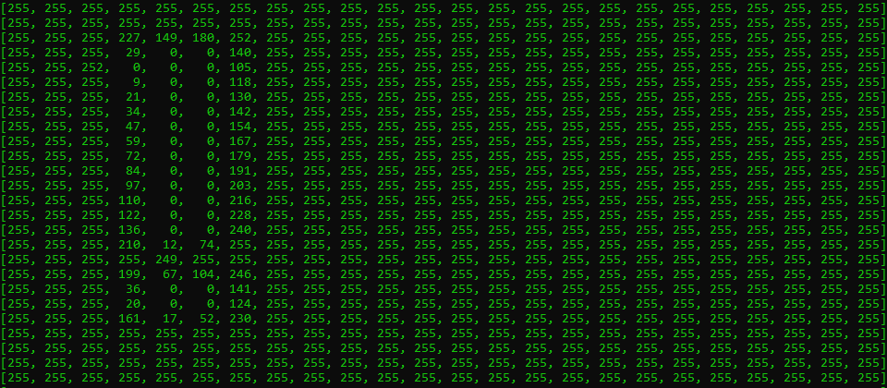
Font Character-Shape Tiebreaker
When Levenshtein fails, compare the shapes of the characters themselves!
Import font or compare with a common one

Slide 27
Part 5:
Conclusion, why not

Slide 28

Yes, it works!
Issues and considerations:
Currently requires hand-holding
Not fully autonomous AI
More testing on different images
Method refinement
Convolutional Neural Networks
Could add:
“Spot the differences“ features
Unstructured list collection
Software creation and UI
Questions?

Slide 29
(that’s it)

